Slide 1



Analyzing Amazon Sales Data
Amazon.com, Inc. transforms e-commerce globally. Founded by Jeff Bezos in 1994, it now leads online sales and digital services. This analysis investigates Amazon sales data for actionable insights.
by Nalluri Madhavi

Slide 2


Project Objective
1
Insight Generation
This analysis aims to extract meaningful insights from the dataset.
2
Pattern Recognition
Identifying trends and patterns within the data is crucial.
3
Feature Relationships
This focuses on relationships between various dataset attributes.

Slide 3


Dataset Description
Feature
Description
Sales Volume
Monthly sales figures across various categories.
Customer Demographics
Information on customer profiles and buying patterns.
Time Period
Data compiled monthly, annually, and seasonally.

Slide 4
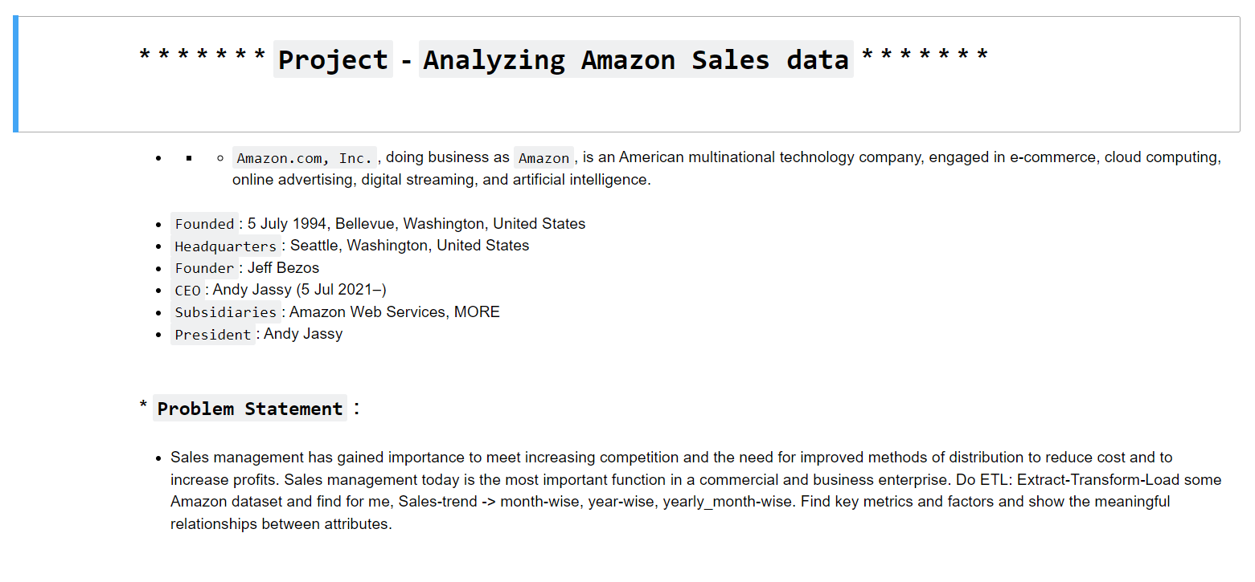
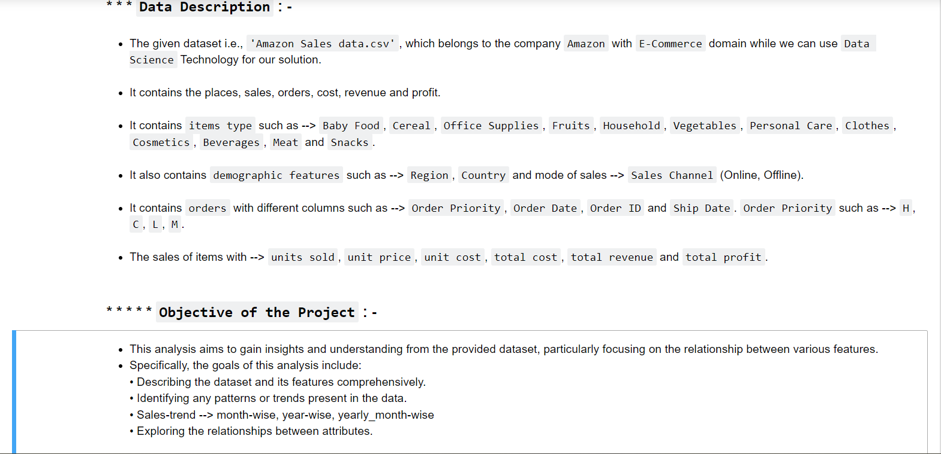

Slide 5
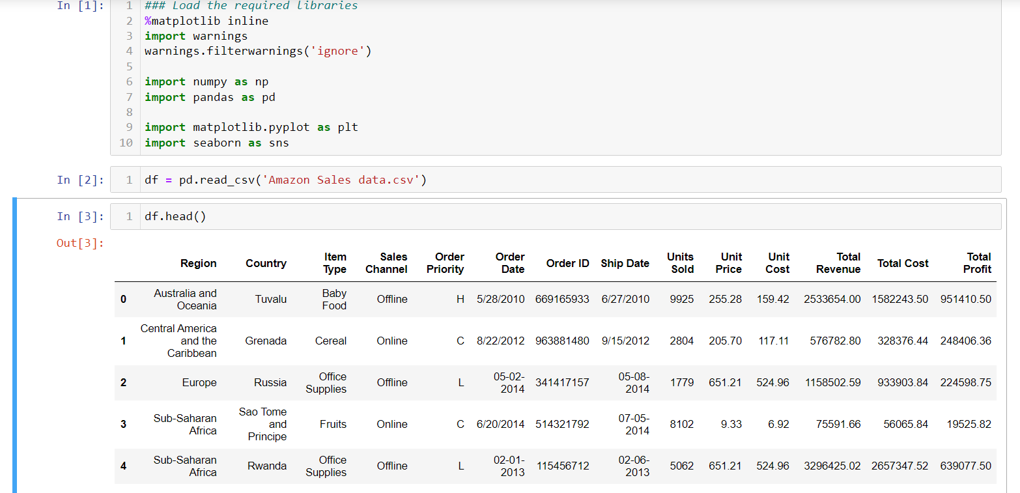

Slide 6


Identifying Trends
1
Month-wise Sales
Sales data shows fluctuations across different months.
2
Year-wise Sales
Annual comparisons reveal overall growth or decline.
3
Yearly Month-wise Comparison
Assessing seasonal patterns helps optimize inventory and offerings.

Slide 7
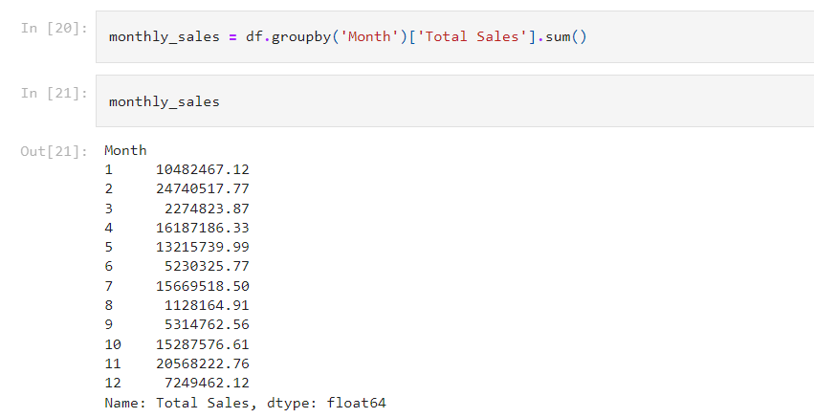
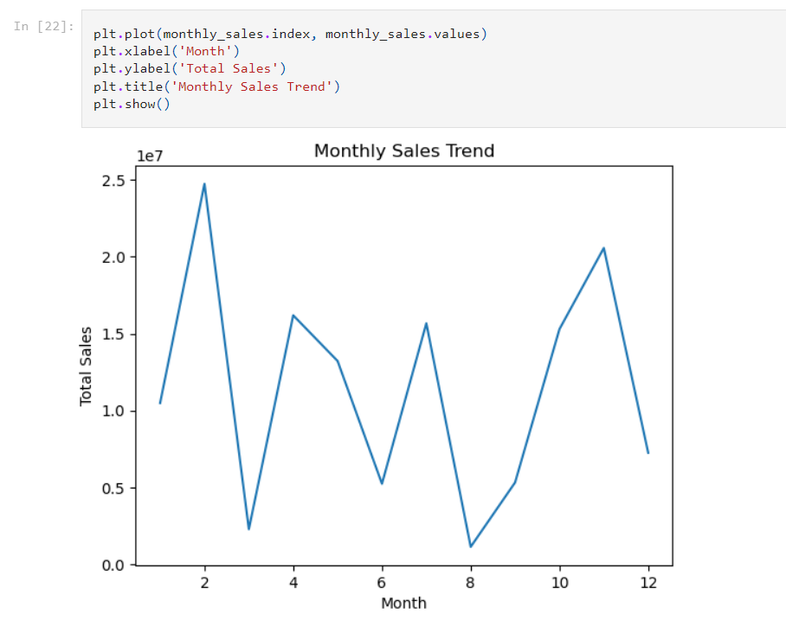

Slide 8
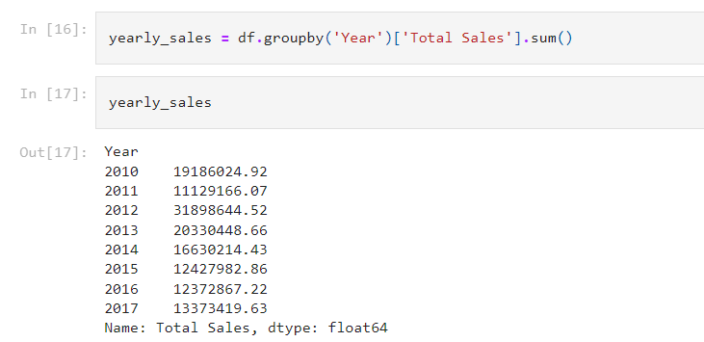
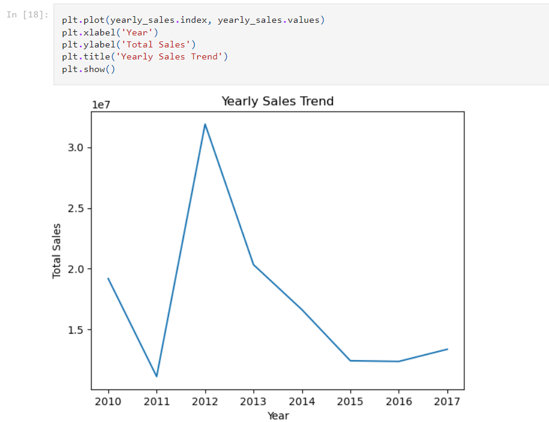

Slide 9
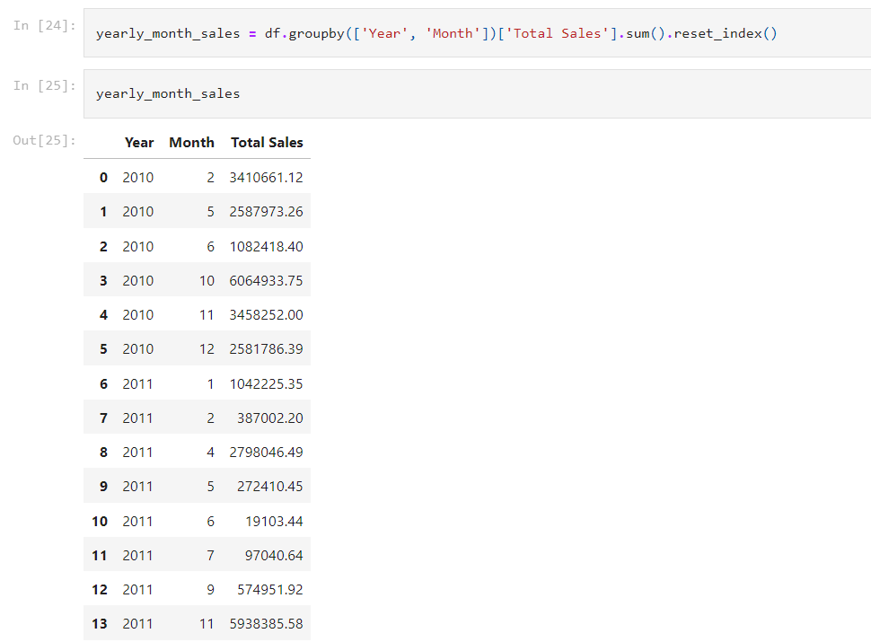
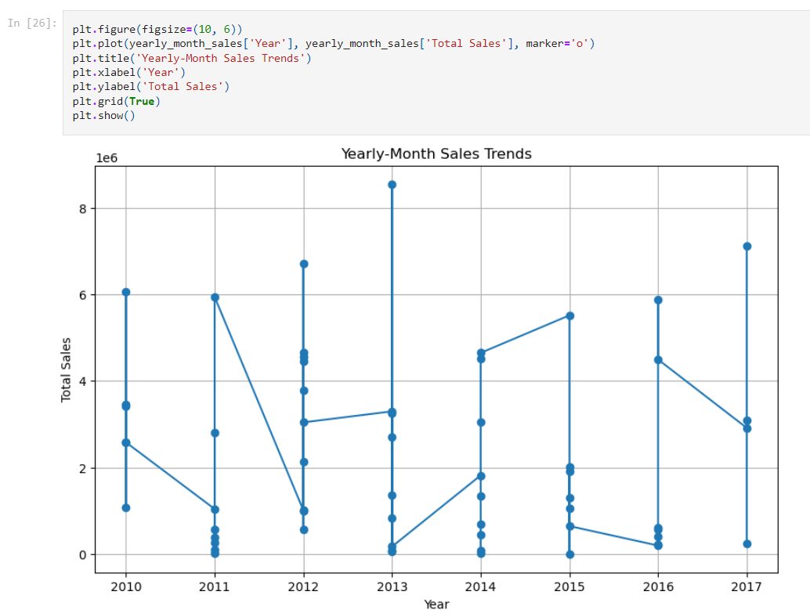

Slide 10
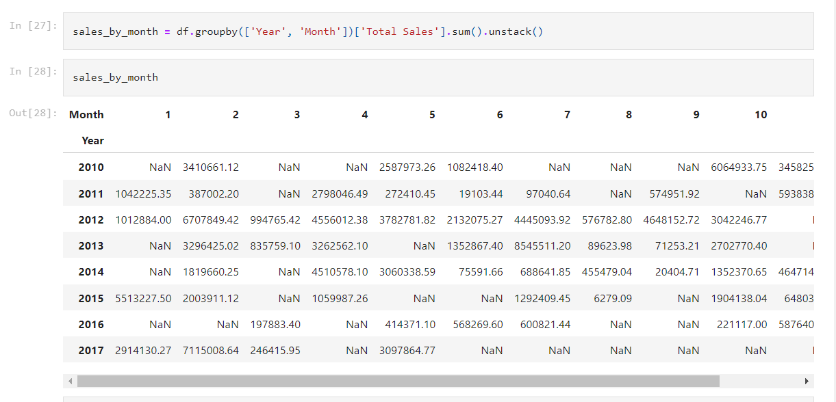
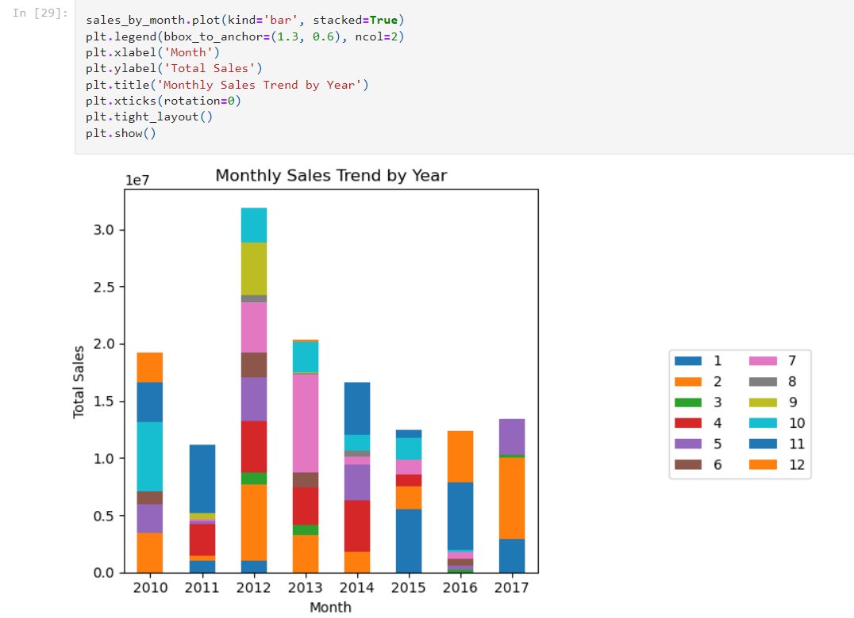

Slide 11

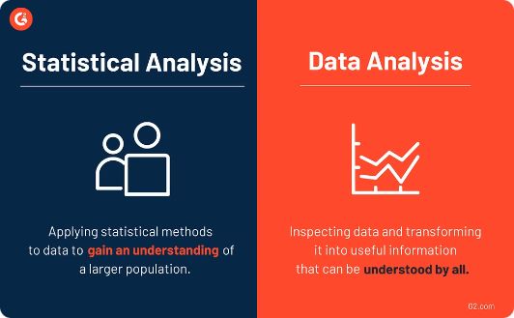
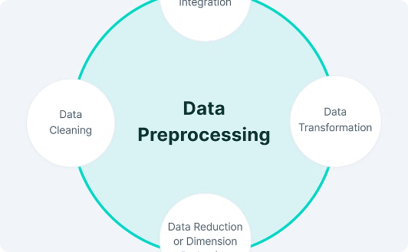
Exploratory Data Analysis
Visual Techniques
Statistical Methods
Data Cleaning
Utilizing charts and graphs to effectively visualize data relationships.
Employing regression analysis and other statistical tools to uncover insights.
Ensuring accurate data through preprocessing and validation steps.

Slide 12
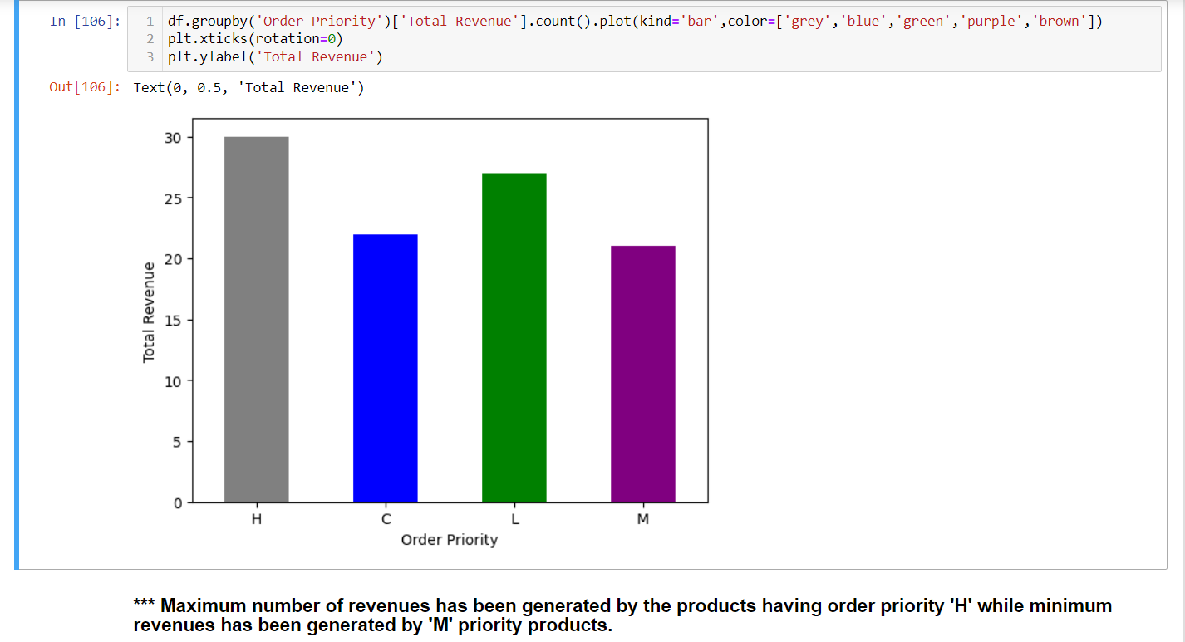
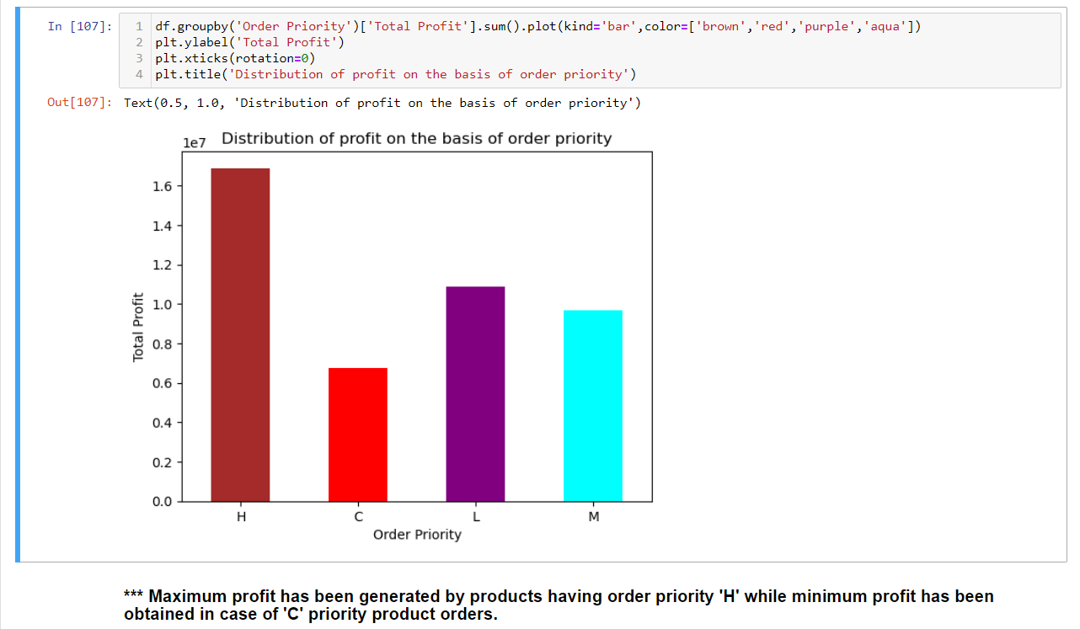

Slide 13
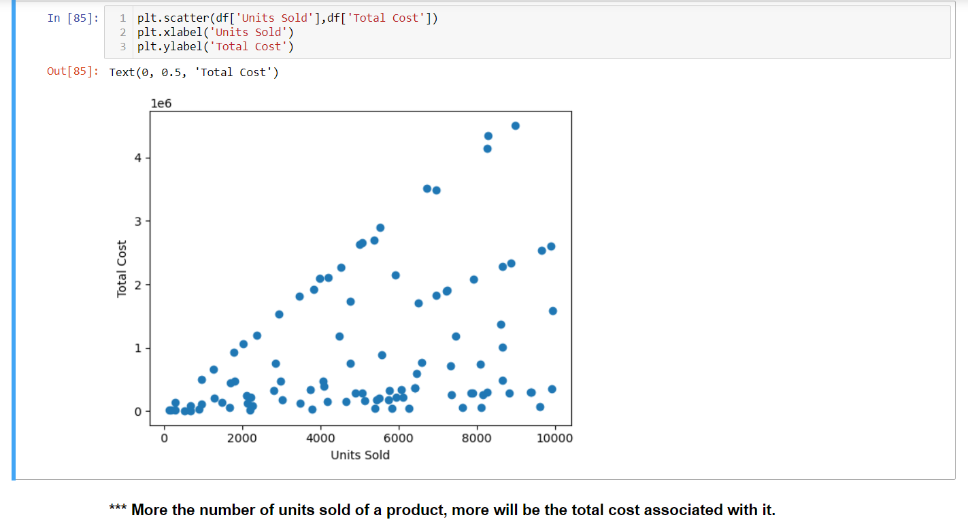
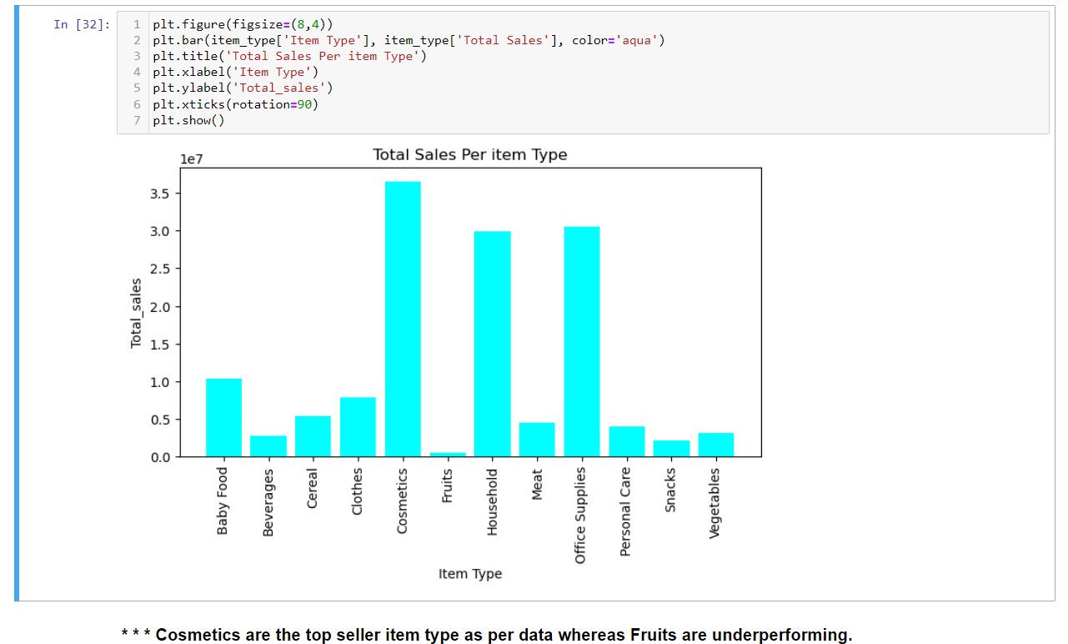

Slide 14
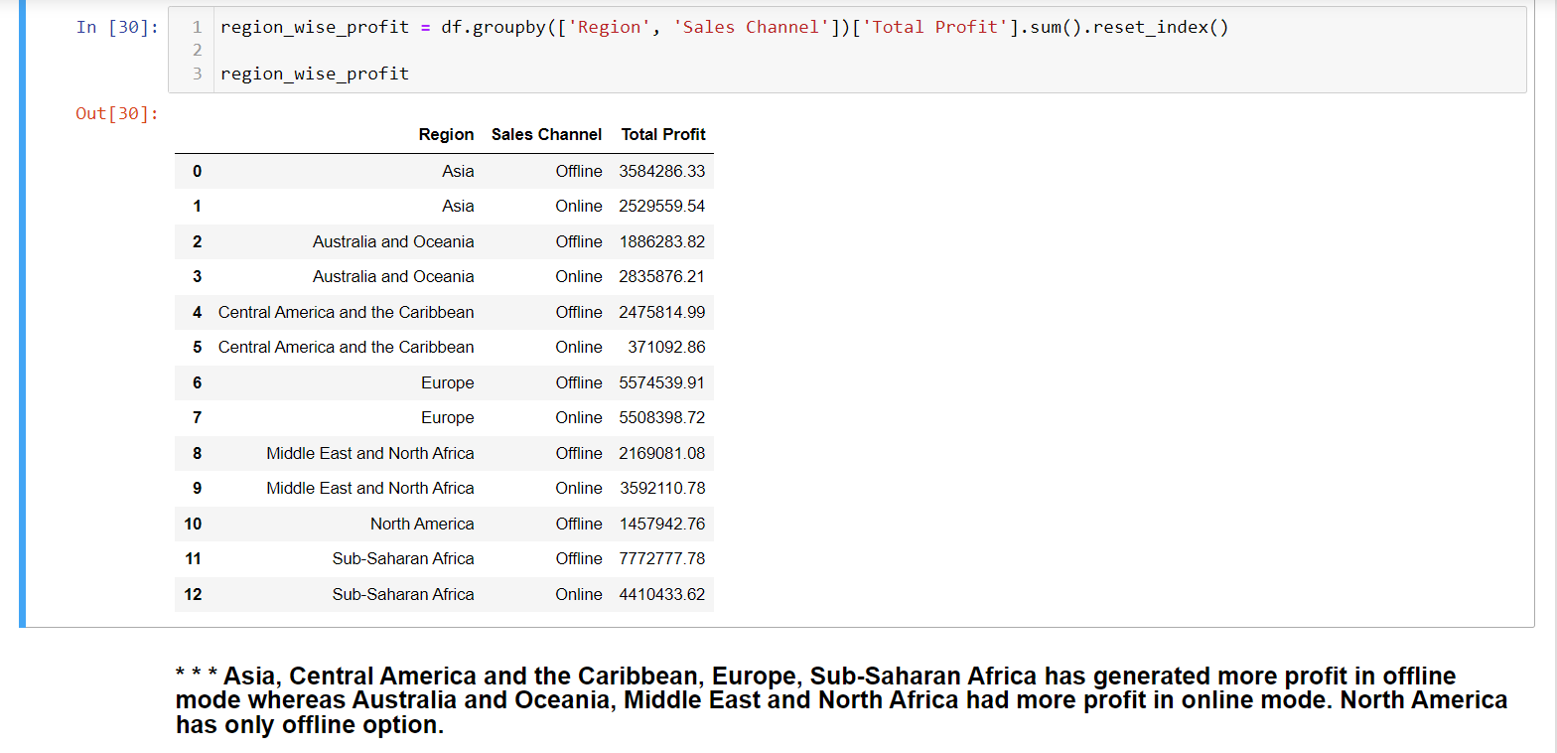
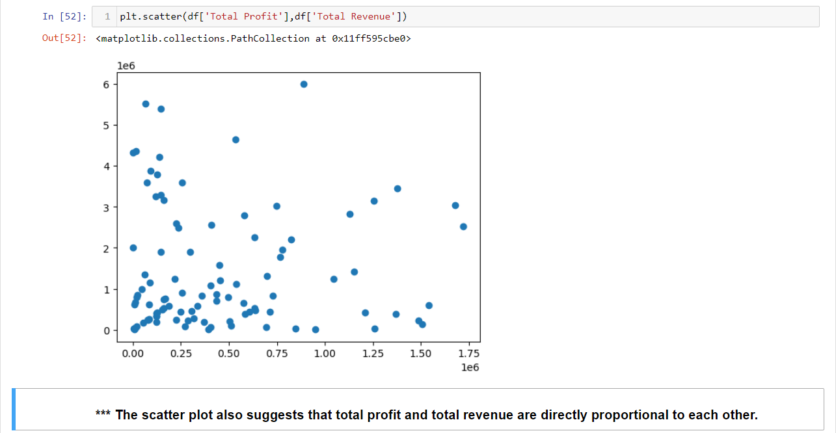

Slide 15
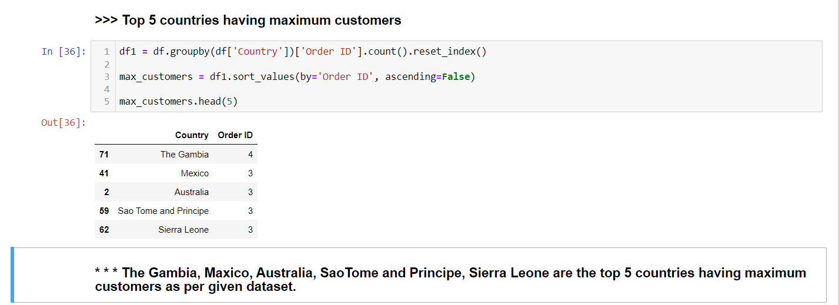
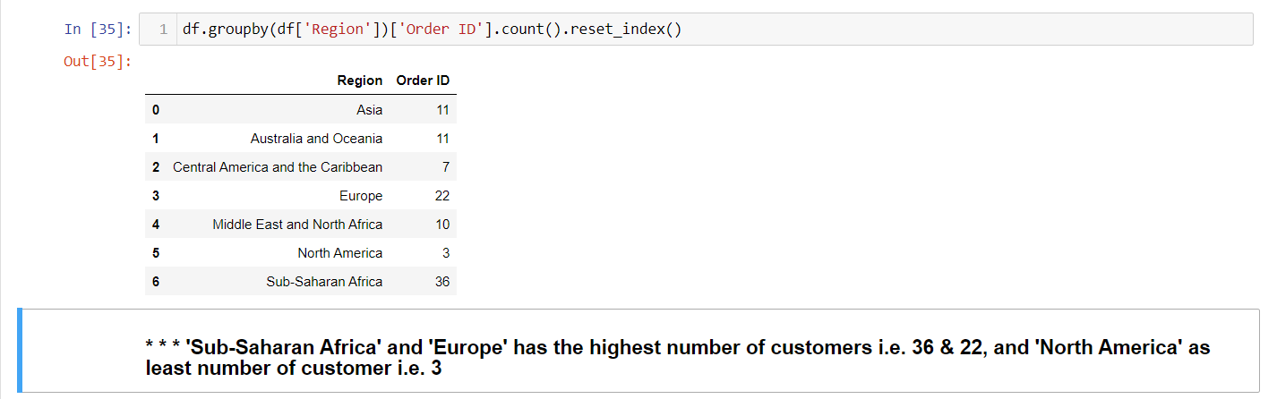

Slide 16
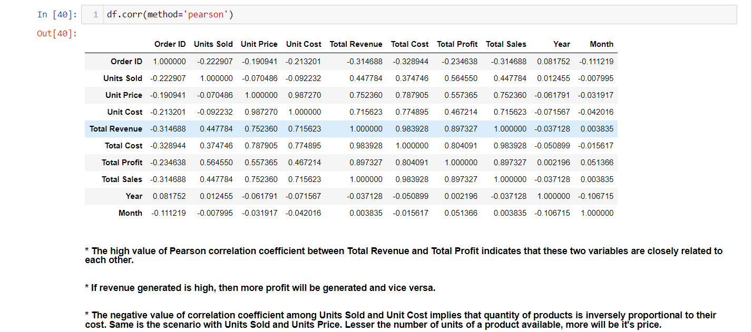
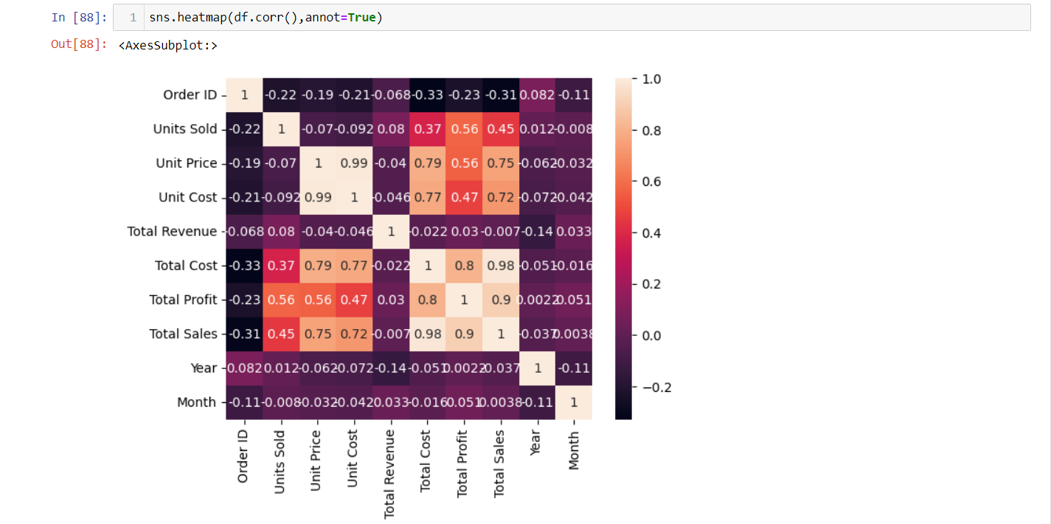

Slide 17
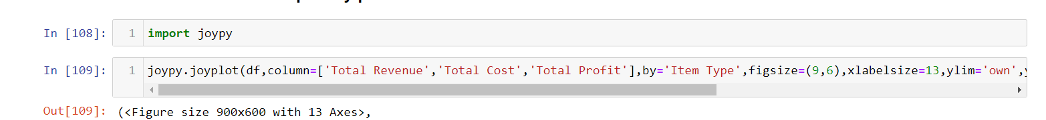
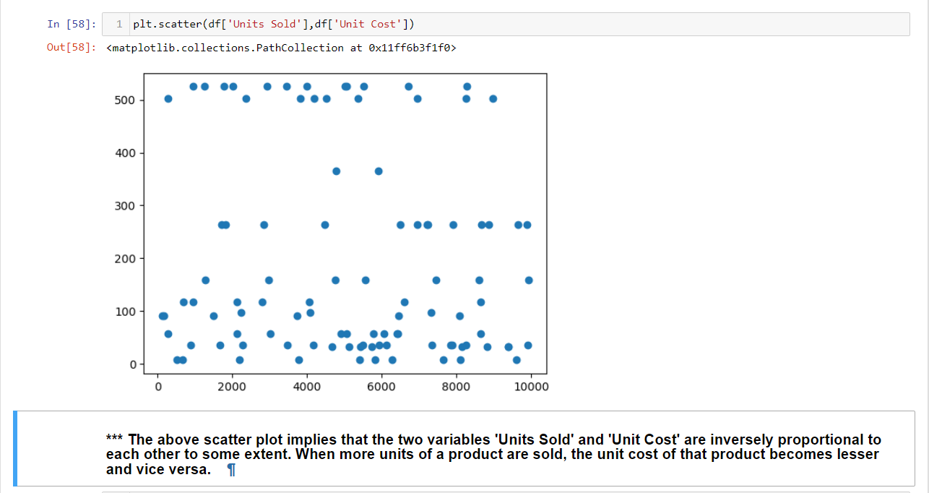
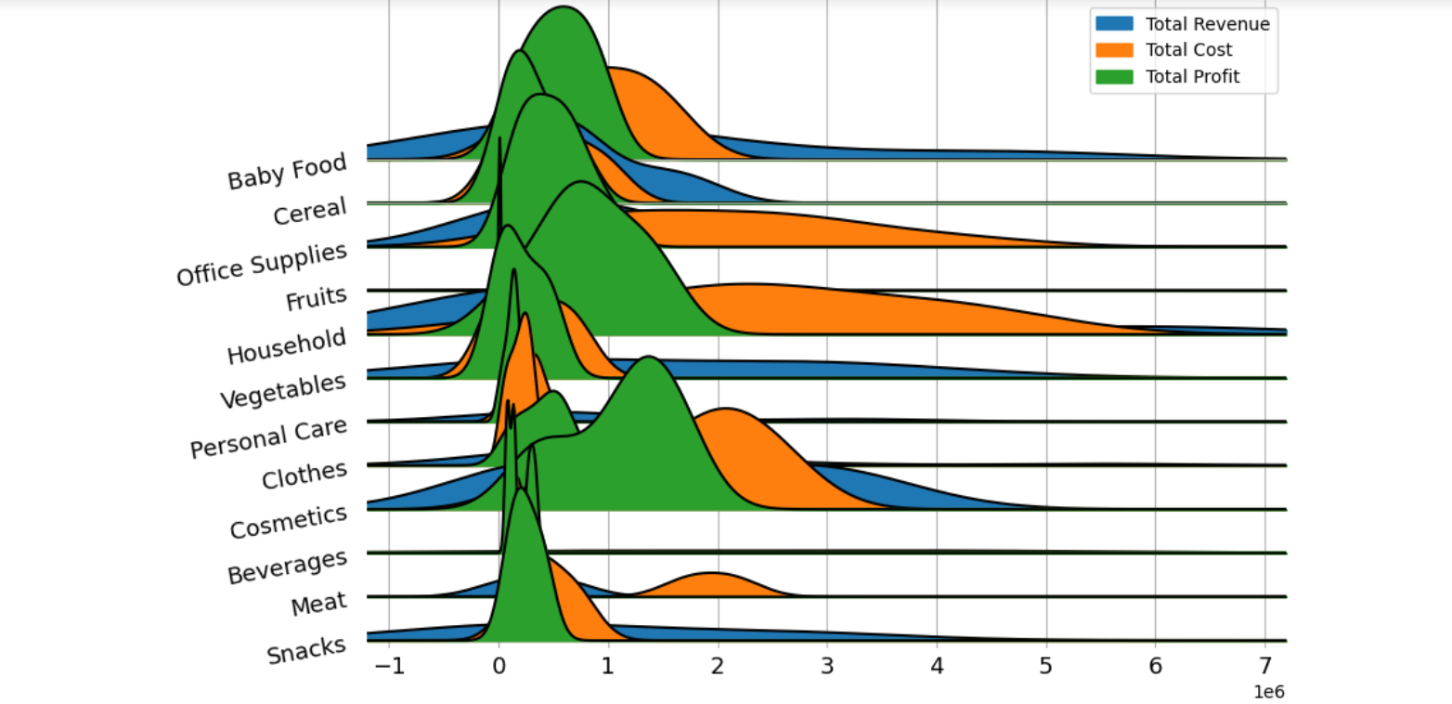

Slide 18
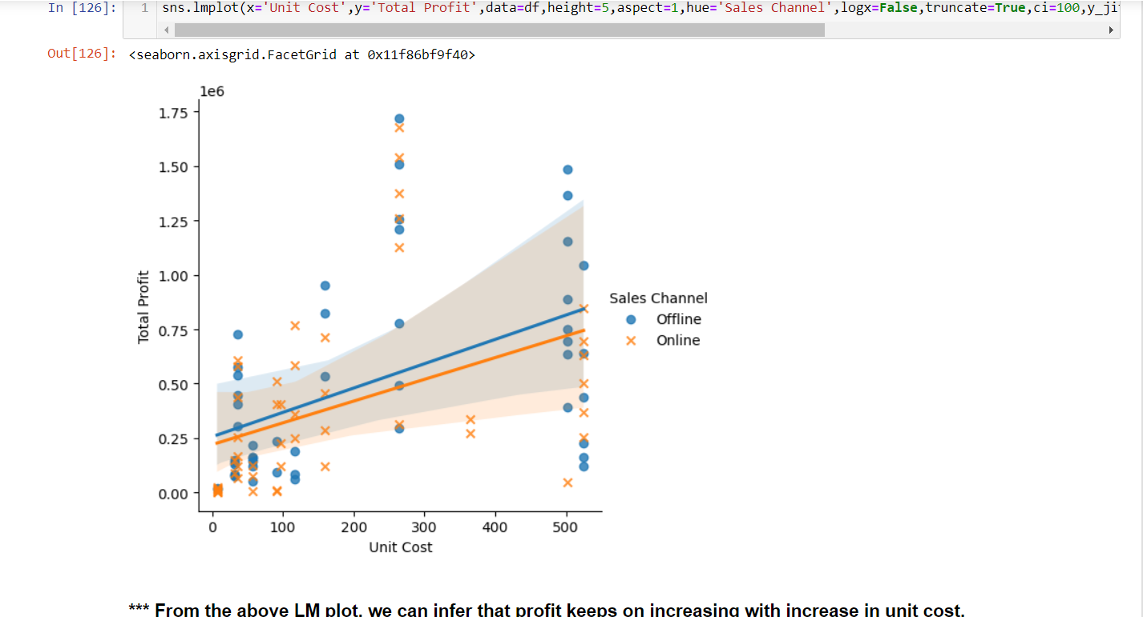
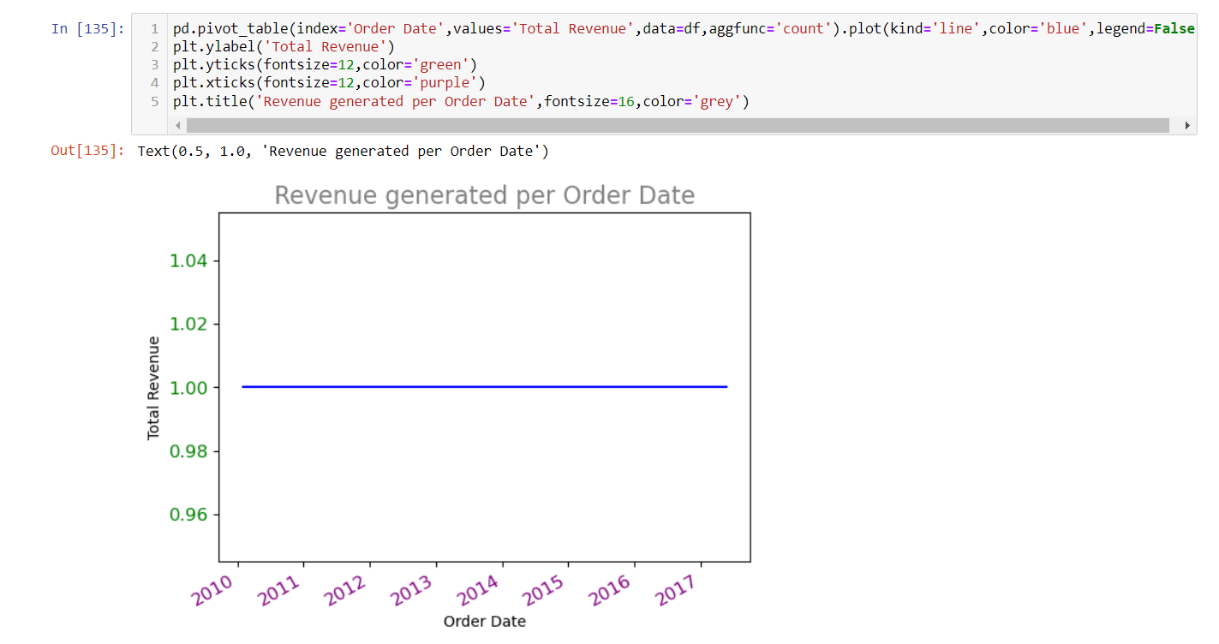

Slide 19
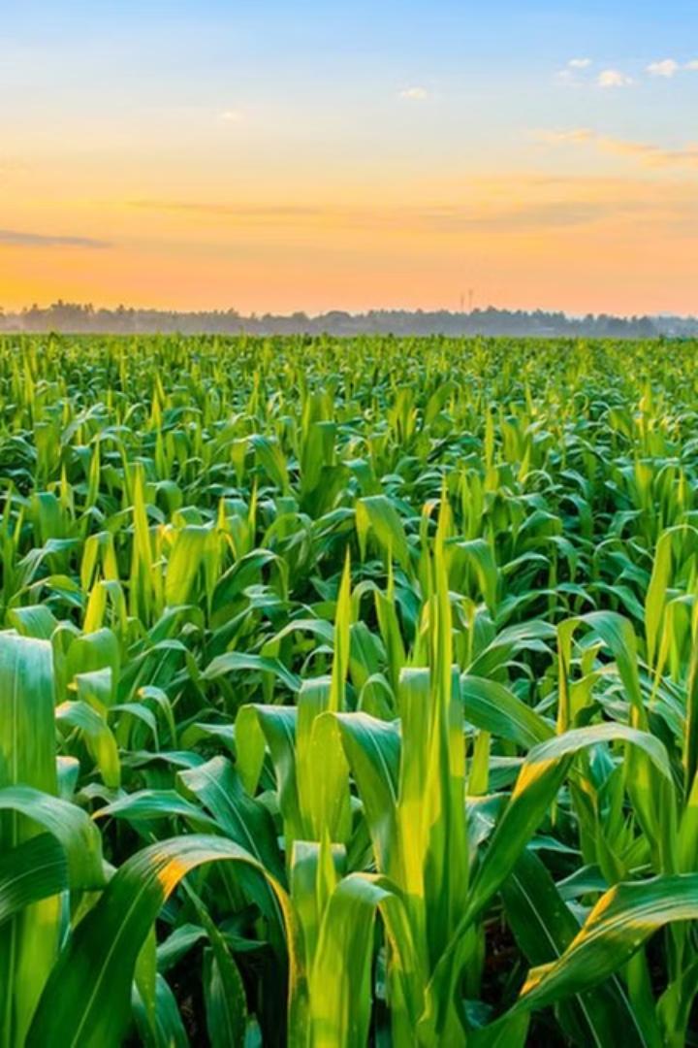
Crop Production Analysis in India
India is among the top three global producers of many crops, including rice, wheat, pulses, cotton, peanuts, fruits, and vegetables. In 2022-23, India's estimated production of major crops was substantial, with foodgrains reaching 3296.87 lakh tonnes, rice at 1357.55 lakh tonnes, and wheat at 1105.54 lakh tonnes. The country's diverse climate and extensive use of canal irrigation and tubewells have enabled the cultivation of crops like rice in areas with less rainfall, such as Punjab, Haryana, and parts of Rajasthan.
by Nalluri Madhavi

Slide 20
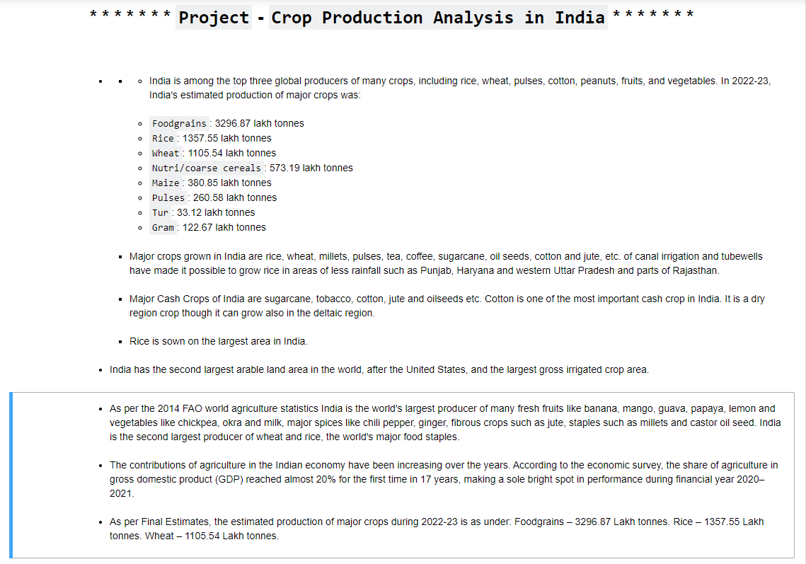

Slide 21
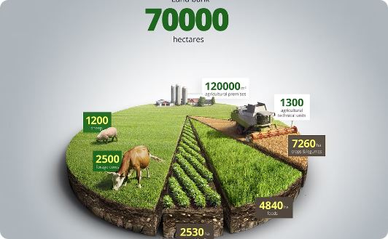

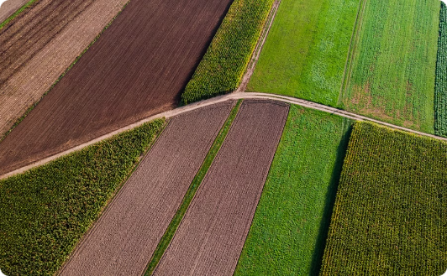
Collaboration for Crop Production Insights
Objective
Stakeholders
Approach
Gain insights and understanding from the dataset, focusing on the relationship between various features to predict crop production and find key indicators.
Facilitate collaboration of farmers, distributors, and policymakers to drive improvements in crop production.
Leverage data to create views, dashboards, and insights that help stakeholders make informed decisions and drive advancements in the agriculture sector.

Slide 22
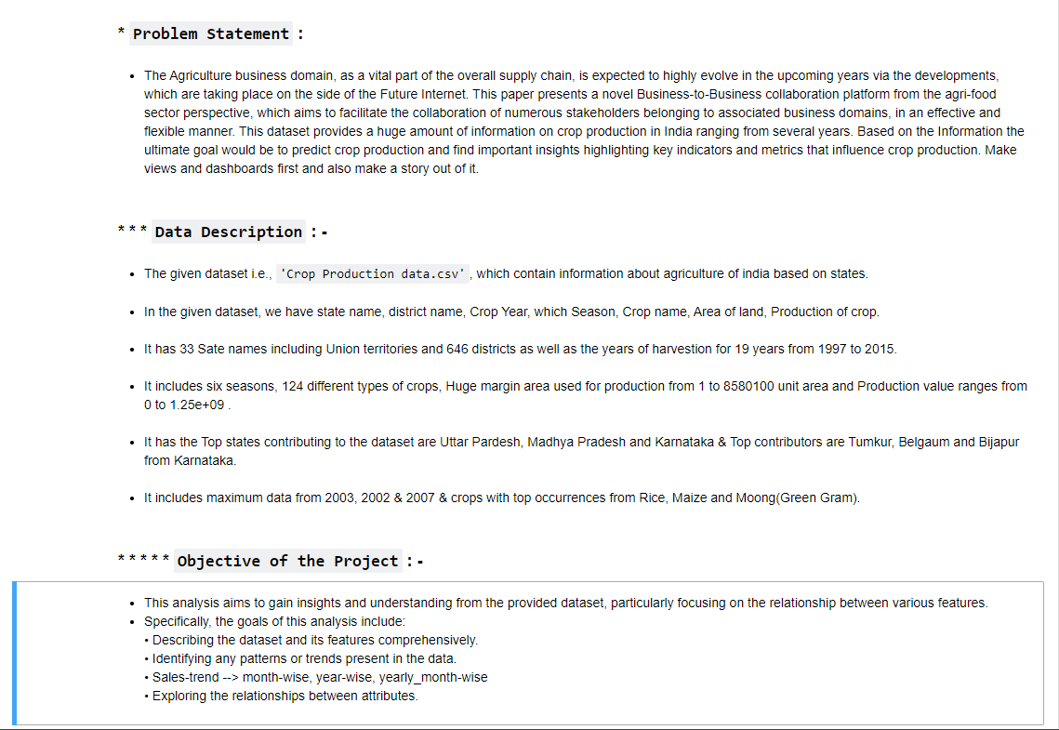

Slide 23
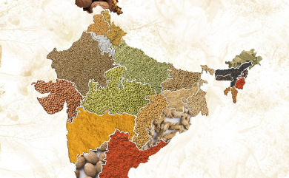
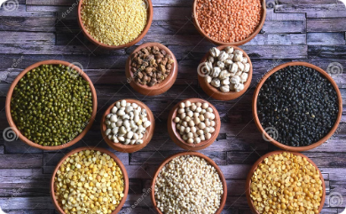
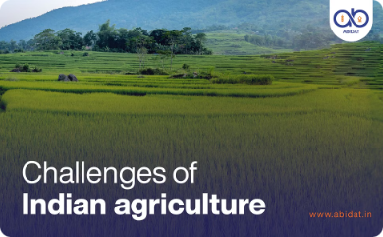
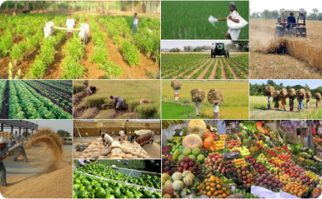
Exploring the Crop Production Dataset
Comprehensive Data
Diverse Crops
Detailed Metrics
Top Contributors
The dataset covers 33 states, 646 districts, and 19 years of crop production data, providing a wealth of information on agriculture in India.
The dataset includes 124 different types of crops, from staple foods to cash crops and a variety of fruits, vegetables, and spices.
The data includes information on land area, production volume, and harvest seasons, providing a comprehensive view of the agricultural landscape.
The dataset highlights the leading crop-producing states and districts, with Uttar Pradesh, Madhya Pradesh, and Karnataka as the top producers.

Slide 24
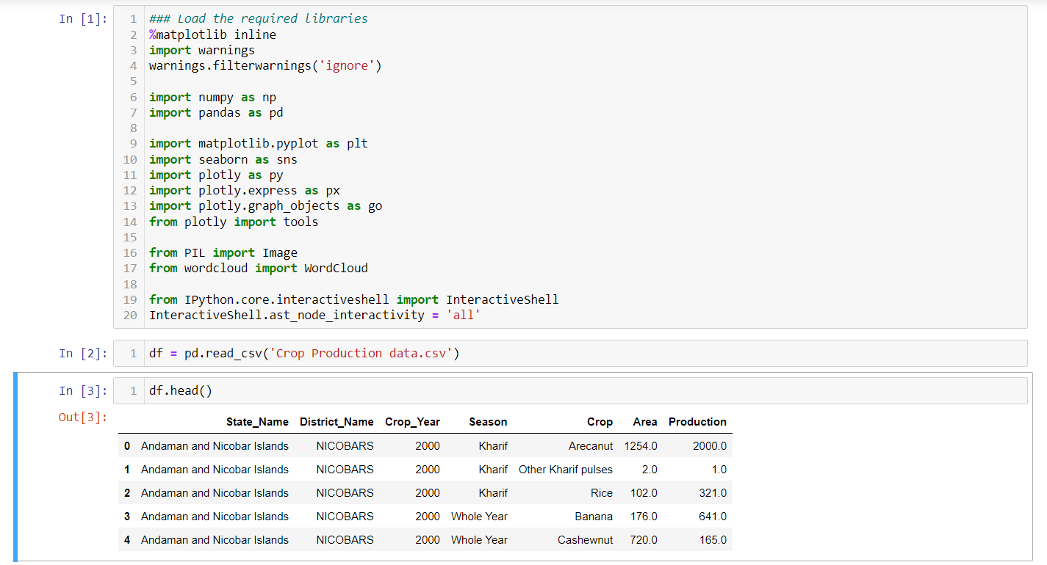
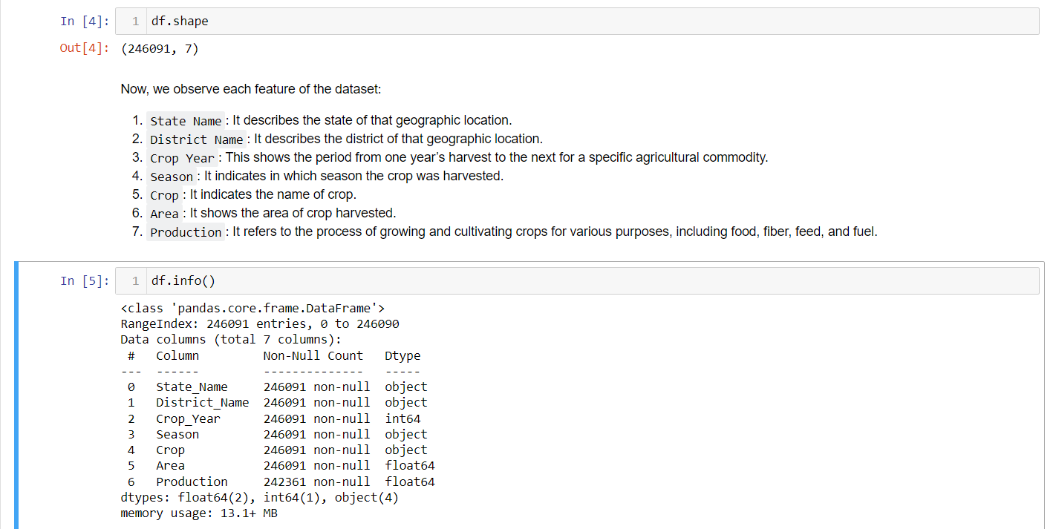

Slide 25
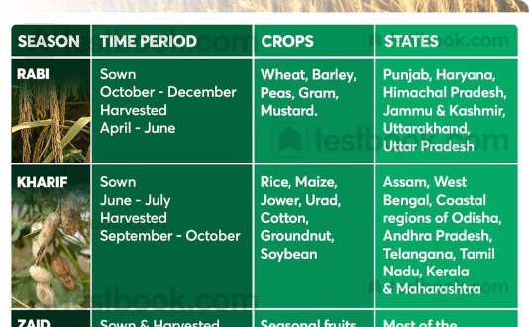
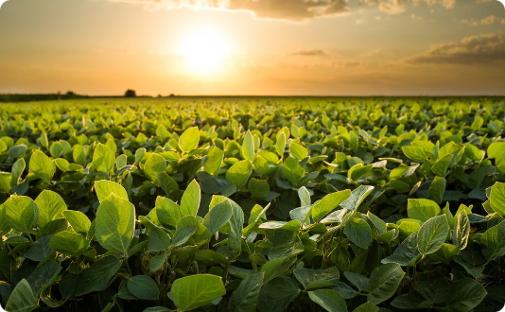

Crop Production Insights
Seasonal Trends
Year-over-Year Variations
Emerging Trends
Distinct seasonal patterns in crop production, with certain crops thriving in specific seasons. Understanding these trends can optimize planting and harvesting.
Significant year-over-year variations in crop yields, influenced by factors like weather, pests, and market conditions. Analyzing these can help stabilize production.
Analysis uncovers emerging trends in crop production, such as increasing popularity of certain crops or new farming techniques. These insights can guide policymakers.

Slide 26
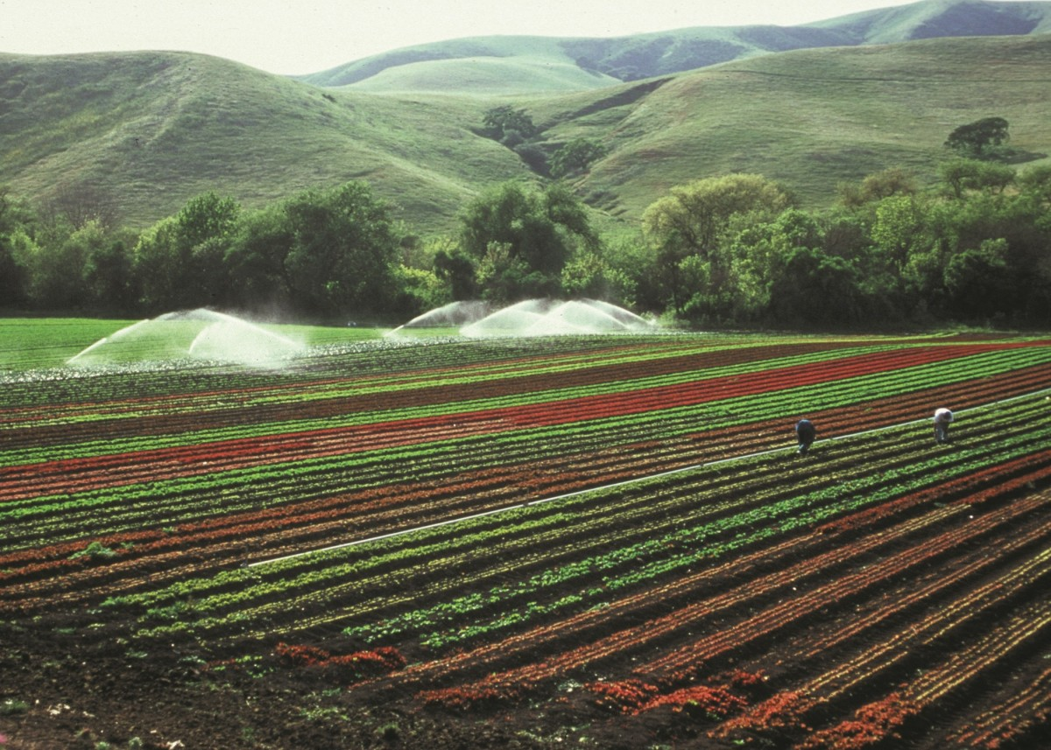

Predicting Crop Production
Key Indicators
Predictive Modeling
Actionable Insights
The analysis will identify the key indicators and metrics that have the most significant influence on crop production, such as weather patterns, soil quality, access to irrigation, and market demand. These insights can inform decision-making and resource allocation.
By leveraging advanced analytics and machine learning techniques, the analysis will aim to develop predictive models that can forecast crop production based on the identified key indicators. This can help stakeholders plan and prepare for future harvests more effectively.
The analysis will translate the findings into actionable insights, such as recommendations for policy changes, infrastructure improvements, or targeted interventions to support and enhance crop production in India. These insights will be presented in the form of views, dashboards, and a comprehensive story.

Slide 27
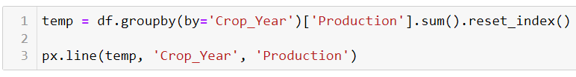
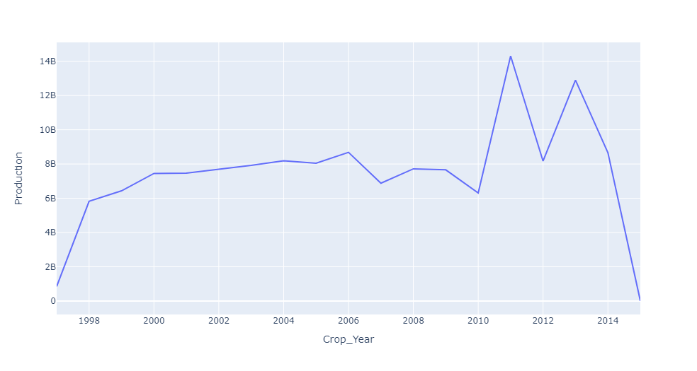
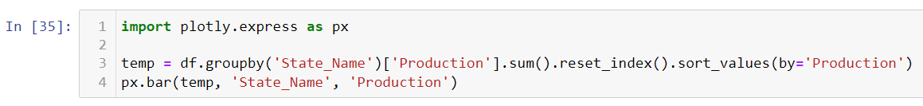
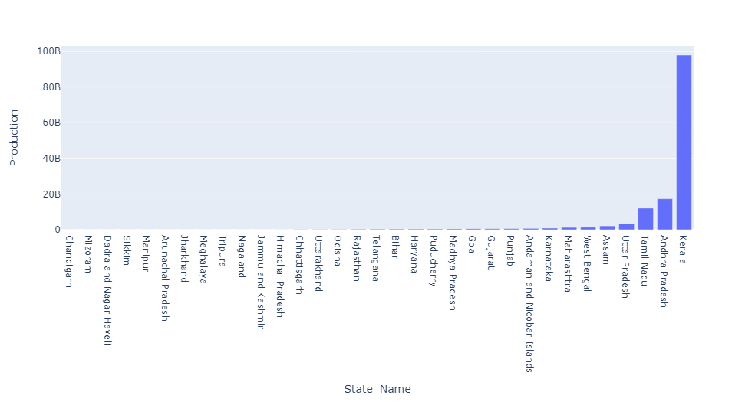

Slide 28
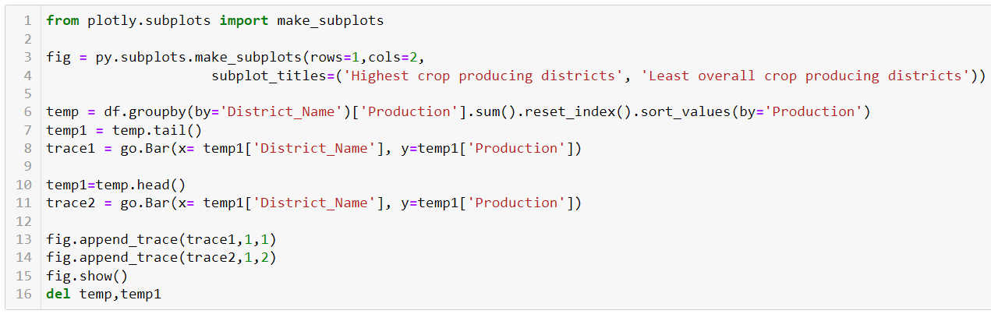
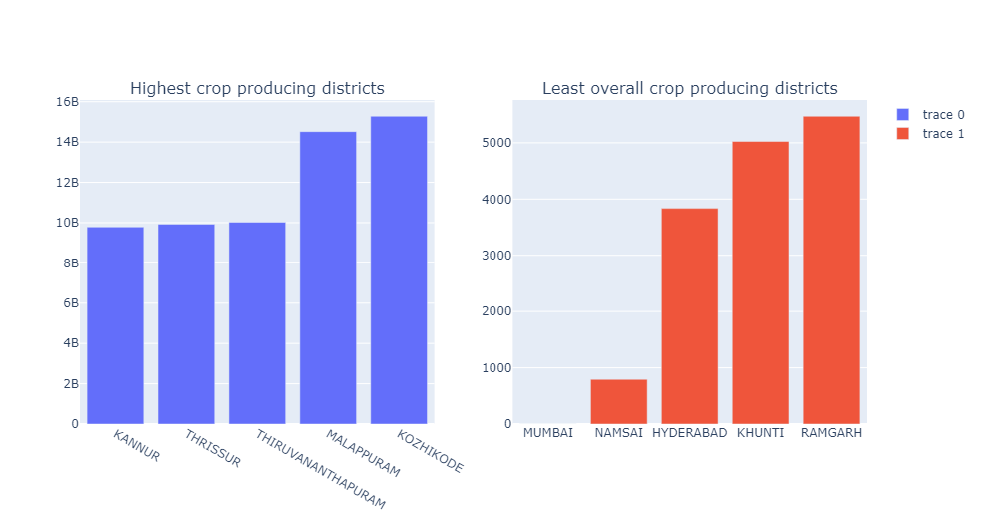
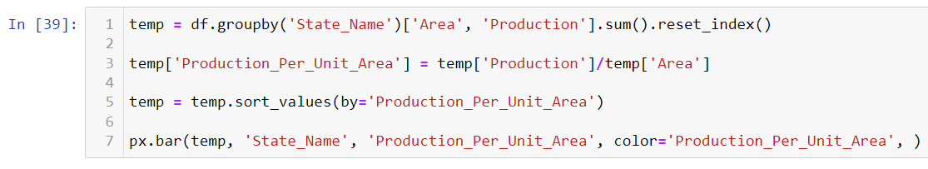
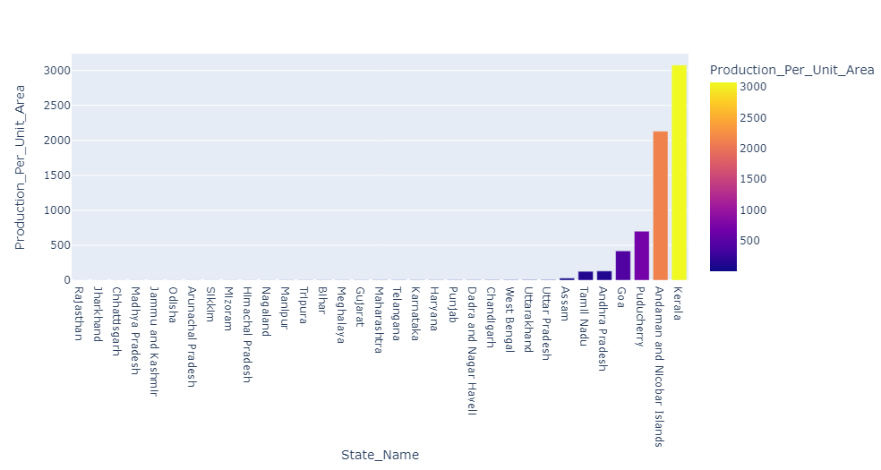

Slide 29



Slide 30




Slide 31





Slide 32




Slide 33





Slide 34



Slide 35





Slide 36




Slide 37





Slide 38

Conclusion
This analysis of Amazon sales data and crop production provides valuable insights. Data-driven decisions from these studies can guide effective strategies in e-commerce and agriculture sectors.

